Slide 1



End-to-End Cloud Financial Data Pipeline on Microsoft Azure
Transforming 13.3 Million Transactions into Actionable Business Intelligence
DAMG 7370 | Northeastern University
Group Members:
Natasha Kiara
Ujunwa Okwuaka
Oloruntobi Salami
GitHub Link: https://github.com/natasha-kiara/financial-transactions-pipeline

Slide 2
The Problem
Without a pipeline
With our pipeline
Raw CSV files sit in folders
Analysts manually download and process data
Decisions made on gut feel, not evidence
No way to detect fraud at scale
No visibility into customer risk
Every transaction automatically processed
Clean, structured data ready for analysis
Fraud flagged before it completes
At-risk customers identified before they leave
Stakeholders access live dashboards — no IT needed
Our goal: build an industry-standard cloud pipeline that transforms raw financial data into decisions a bank can act on

Slide 3
The Dataset
File | Rows | What it Contains
transactions_data.csv | 13.3 million | Every card transaction across the 2010s — amount, merchant, date, card used
cards_data.csv | 6,146 | Card details — type, brand, limit, chip status, PIN history
users_data.csv | 2,000 | Customer demographics — age, income, debt, credit score
mcc_codes.json | Lookup | Merchant category codes — maps numeric codes to business types
train_fraud_labels.json | 13,332 | Binary fraud labels — ground truth for supervised ML
Key challenges:
$ signs embedded in 5 numeric columns — amount, credit limit, income, debt
1.56M null merchant states — cause confirmed by EDA
Security columns requiring removal — CVV, card number
Severe class imbalance — 13,332 fraud cases in 13.3M transactions (0.1%)

Slide 4
What We Set Out to Answer
Where is fraud concentrated, and can we predict which transactions are fraudulent before they're processed?
Which customers are quietly disengaging, and what do they look like demographically?
How has customer spending changed across the decade? Are there seasonal or category patterns?
Which states and merchant types drive the highest transaction volume — and the highest fraud?
What does our customer base look like in terms of income, debt, and credit health?
Are there distinct customer profiles we can identify and serve differently?

Slide 5
Why Microsoft Azure?
🇨🇦 PIPEDA Compliance - All data stored in Canada Central region. Canadian financial regulations require customer data to remain within Canada.
📊 Power BI - Native integration with Azure Synapse Analytics. No additional connectors or exports required.
🏦 Industry Alignment - Canada's banks run on Azure. This project mirrors the actual stack used in Canadian financial services.

Slide 6
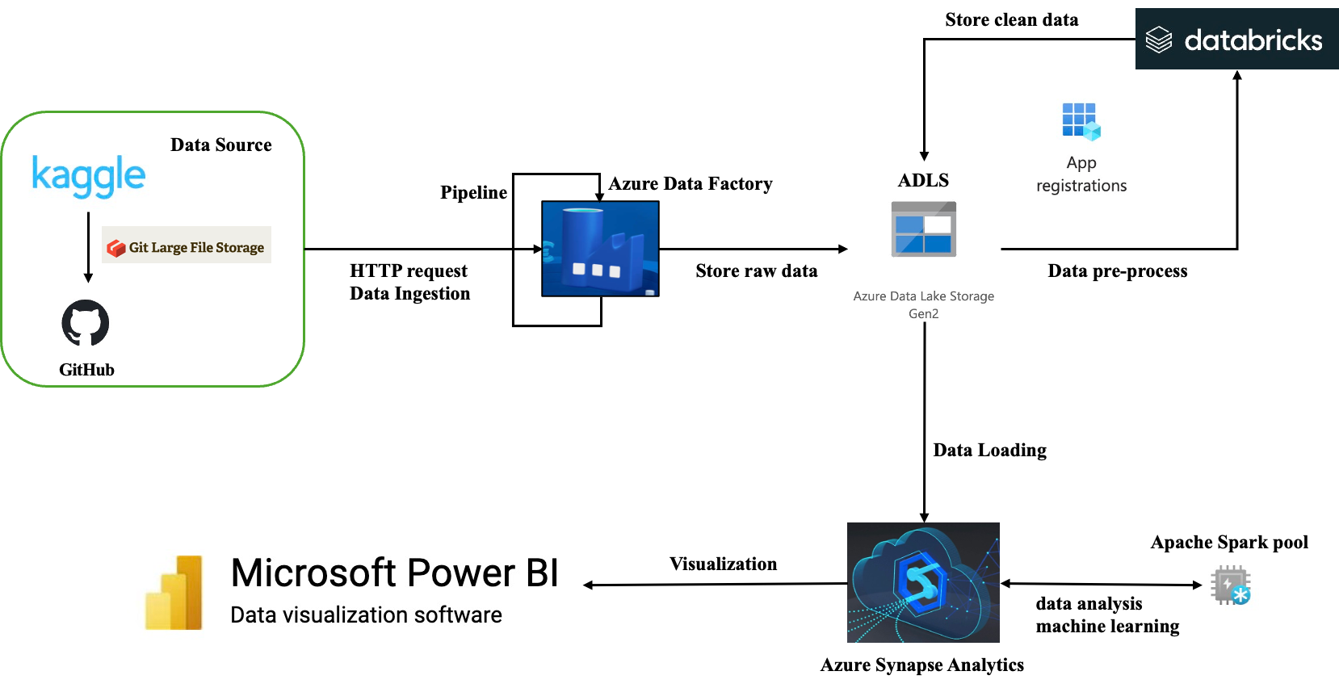
Architecture Diagram
GitHub → Azure Data Factory → ADLS (raw/cleaned/curated) → Databricks → Synapse → Power BI
• Data stored in Canada Central (PIPEDA compliance)
• Medallion architecture improves data quality step-by-step

Slide 7
Medallion Architecture
raw/ → original data, no changes​
cleaned/ → fixed data types, handled nulls​
curated/ → structured into star schema​
Parquet used because:
• Column-based (faster queries)
• Better compression
• Optimized for Synapse

Slide 8
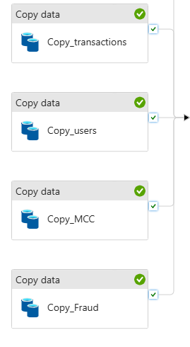
Data Ingestion
Five parallel Copy Data activities running simultaneously:
Git LFS GitHub's 100MB file limit exceeded by transactions CSV. Git Large File Storage routes large files through GitHub's dedicated LFS infrastructure automatically.
Linked Services Two registered connections — ls_github_http and ls_adls_fintech (ADLS Gen2 account key). ADF connects to both.
Parallel Ingestion All five files copied simultaneously, not sequentially. Total ingestion completes faster than copying one file at a time.

Slide 9
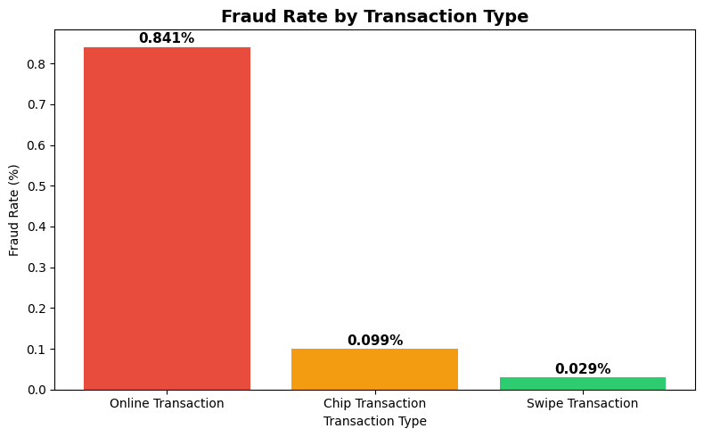
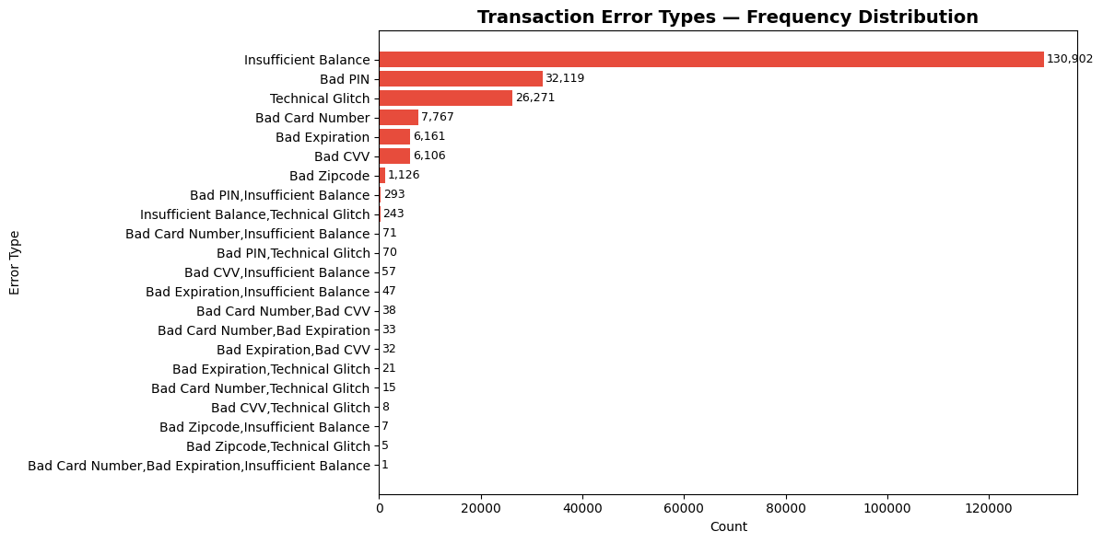
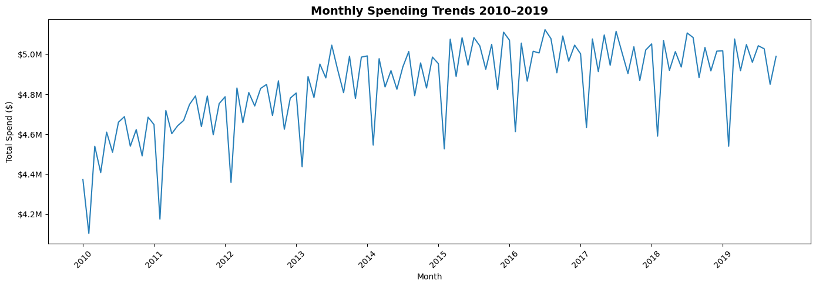
Exploratory Data Analysis — What We Found First
22 investigations ran across transactions, cards, customers, and cross-file joins before a single cleaning decision was made
Online transactions carry the highest fraud rate — drives feature engineering
Insufficient Balance dominates at 130,902 — the strongest financial stress signal
Spending grew steadily 2010–2013, then estabilised — no gaps or drop-offs confirm dataset completeness across the full decade

Slide 10
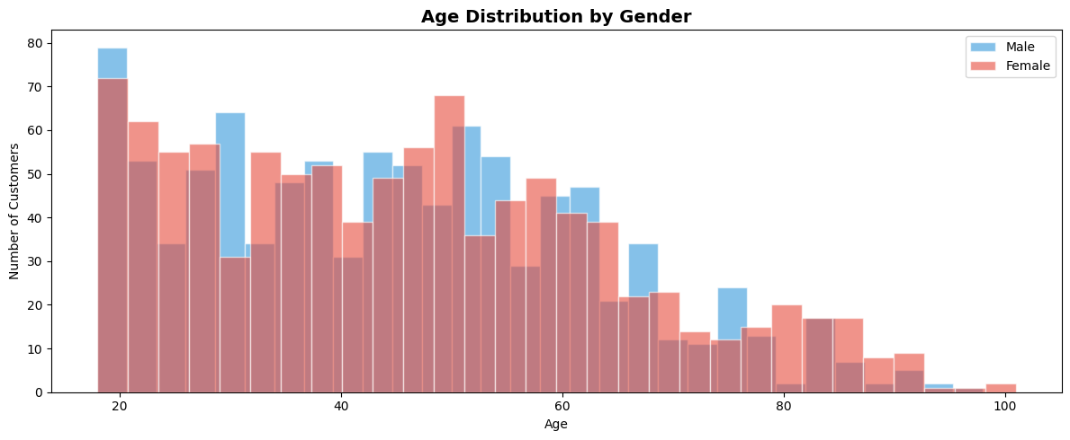
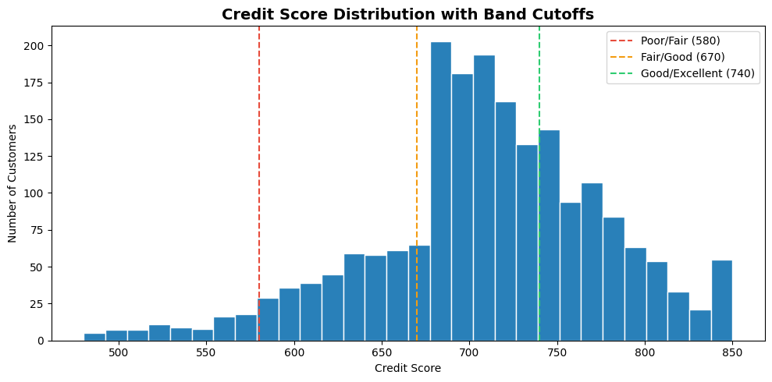
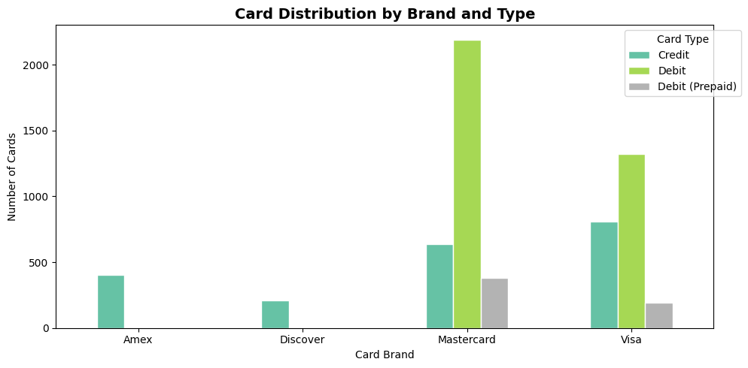
Exploratory Data Analysis — What We Found First
Age distribution is broadly similar across genders — peak customers in the 30–60 range
Credit score distribution confirms natural band cutoffs at 580, 670, and 740
Mastercard Debit dominates at 2,191 cards — Amex is 100% credit with no debit products

Slide 11
Key Insights from Exploratory Data Analysis
Spending trends show steady growth across the years, confirming consistent data coverage.
Fraud is more influenced by transaction location than amount.
Majority of customers fall within the 30–60 age group.
Credit scores naturally group into clear bands (Poor, Fair, Good, Excellent).
Debit cards are the most commonly used, while Amex is strictly credit-based.
Fraud cases are extremely rare compared to total transactions (high class imbalance).
From these EDA findings, we identified key data issues and patterns, which guided our cleaning and feature engineering steps.

Slide 12
Data Cleaning
Cleaning Action | Justification
Strip $ from amount, credit_limit, yearly_income, total_debt, per_capita_income | EDA confirmed all five stored as strings — arithmetic impossible on string columns
Fill 1.56M null merchant_states → "Online" | EDA groupby confirmed 100% of null states are Online transactions
Fill 5,788 remaining nulls → "Unknown" | Small residual — chip transactions with missing state
Drop zip | 1.65M nulls + 25,256 unique values + fully redundant with city and state
Drop CVV, card_number | Security compliance — must never appear in an analytics system
Drop card_on_dark_web | Zero variation — all 6,146 cards returned "No" confirmed by EDA
Fill errors nulls → "No Error" | 13M nulls = clean transactions. Null means no error occurred
Join fraud labels | 13,332 transactions matched to ground truth fraud labels
Join MCC codes | Human-readable merchant categories added to 13.3M transactions

Slide 13
Feature Engineering
Features were engineered to serve two consumers — the Synapse SQL views that power the dashboards, and the ML models that produce predictions
Transaction-level features (used by fraud model + Synapse fraud view):
is_home_state — does transaction state match customer's home state?
is_high_risk_hour — transaction between 11pm and 5am?
amount_vs_customer_avg — deviation from customer's average spend
use_chip_encoded — transaction method as numeric
merchant_state_encoded, merchant_category_encoded — categorical encoding for ML
Customer-level features (used by segmentation model + Synapse customer/retention views):
avg_txn_count — total transactions per customer
avg_days_inactive — days since last transaction
avg_spend_per_transaction — average spend amount
error_rate — proportion of transactions with errors
insufficient_balance_count — count of Insufficient Balance errors
pct_online_transactions — share of online vs physical
debt_to_income_ratio — total_debt / yearly_income
has_expired_card — whether customer holds an expired card
account_tenure_days — days since account was opened
credit_score_band — Poor / Fair / Good / Excellent
age_group — Under 30 / 30–44 / 45–59 / 60+

Slide 14
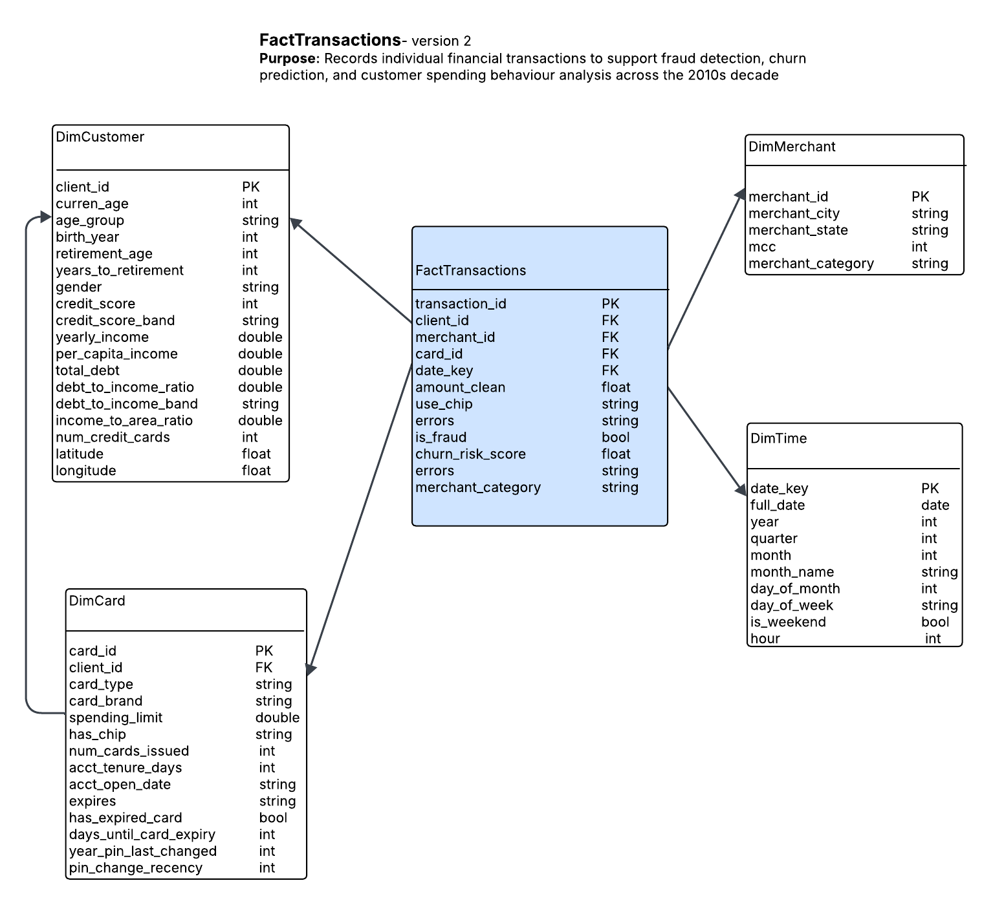
Data Modeling (Star Schema)
Grain: One row = one financial transaction made by one customer using one card at one merchant at one point in time. 13.3 million rows. Never aggregated

Slide 15
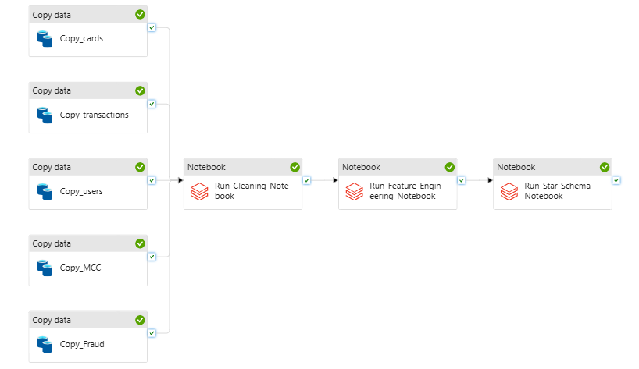
Orchestration- One Trigger, End-to-end
All 5 Copy activities run in parallel → cleaning waits for all 5 to succeed → feature engineering runs → star schema runs.

Slide 16
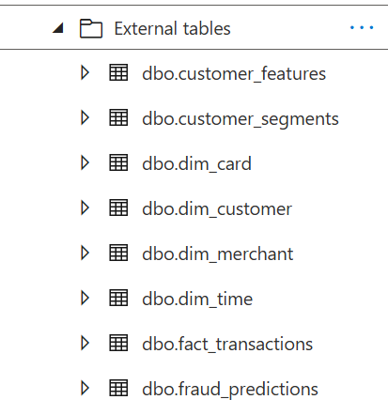
Data Storage (Warehouse)
Data stored in Synapse as external tables
Data read directly from curated Parquet files
Table | Source in ADLS
fact_transactions | curated/fact_transactions/
dim_customer | curated/dim_customer/
dim_card | curated/dim_card/
dim_merchant | curated/dim_merchant/
dim_time | curated/dim_time/

Slide 17
Data Analysis
View | Stakeholder | What It Returns
vw_monthly_transaction_trends | Bank Manager | Monthly volume and spend across the decade
vw_card_and_merchant_summary | Bank Manager | Card usage breakdown and top merchants
vw_busiest_periods | Bank Manager + Fraud | Peak transaction days and hours
vw_customer_spending_by_segment | Marketing | Spend patterns by income and age group
vw_credit_health_and_errors | Credit Risk | Error rates and debt profiles by customer
vw_fraud_hotspots | Fraud Team | Fraud concentration by state and merchant category
vw_fraud_analysis | Fraud Team | Fraud by transaction method and time of day
vw_churn_risk_segments | Marketing + Retention | K-Means segment assignments and risk signals
vw_retention_priority | Retention | Voluntary disengager customers ranked by inactivity
vw_fraud_customer_overlap | Fraud + Risk | Customers appearing in both fraud and stress signals

Slide 18
ML Component 1: Customer Segmentation
Segment | Size | Key Signal | Bank Action
Voluntary Disengagers | 429 customers (35%) | 38.5 days inactive · lowest transactions (7,409 avg) · low errors | Proactive retention outreach before they leave
Financially Stressed | 512 customers (42%) | Almost zero inactivity · highest error rate · 114 avg Insufficient Balance errors | Financial wellness products · credit limit review
Power Users | 278 customers (23%) | Highest transactions (16,144 avg) · highest spend ($56.91 avg) · lowest fraud rate | Loyalty rewards · premium card offers
The Churn Finding: "We applied five methodologies to derive a churn label — 60-day inactivity threshold, 180-day threshold, transaction frequency comparison, K-Means k=2, and PCA + clustering. None produced a viable churn label. EDA had already shown why: the dataset exhibits consistent decade-long growth with no natural disengagement patterns. The data was designed for fraud detection, not churn prediction
The Segmentation Result: K-Means k=3 revealed three actionable customer profiles:

Slide 19
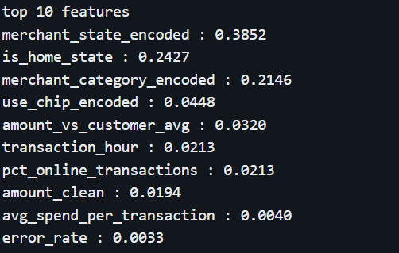
ML Component 2: Fraud Detection
Metric | Logistic Regression | Random Forest | Isolation Forest
AUC-ROC | 0.9522 | 0.9843 | 0.8627
AUC-PR | 0.1099 | 0.1887 | 0.4020
Fraud Recall | 92.1% | 96.8% | 1%
False Alarms | 336,311 | 83,221* | 30
Needs Labels | Yes | Yes | No
Fraud in this dataset is primarily geographic — where the transaction happens and whether it's in the customer's home state explains 63% of fraud prediction. Amount matters far less than location
feature importance:

Slide 20
Layered Fraud Detection
Three-tier table:
Tier | Threshold | Volume | Fraud Caught | Fraud Rate | Action
Tier 1 — Auto Block | Score > 0.8 | ~56,600 | ~4,900 | ~8.7% | Block immediately. No review needed.
Tier 2 — Investigate | Score 0.5–0.8 | ~364,500 | ~7,500 | ~2.1% | Queue for investigator review within 24h.
Tier 3 — Monitor | Score < 0.5 | ~12.88M | ~900 | ~0.01% | Proceed normally. Passive monitoring only.
No single model is optimal for this problem. Random Forest catches known fraud patterns. Isolation Forest catches novel anomalies with near-zero false alarms. We combine both into one score.
Combined score formula: Combined Score = (0.6 × RF probability) + (0.4 × IF anomaly score)
RF weighted higher — trained on labelled fraud data. IF weighted lower but adds genuine unsupervised signal for patterns RF has never seen.

Slide 21
Insights & Challenges
Key Insights:
93.5% of fraud caught — geographic location predicts fraud more than transaction amount
35% of customers disengaging quietly — no financial stress, just inactive — retention window still open
42% financially stressed — high activity, high Insufficient Balance errors — intervention opportunity
Challenges & Lessons:
Five churn methodologies exhausted — no viable label Data dictates the approach. When it says no, pivot
13M rows hit cluster limits — IF required a 10% sample Sampling is a legitimate engineering response at scale

Slide 22
Future Work
Full ML Automation Add Databricks notebook activities to ADF orchestration for fully automated model retraining on a schedule.
Real-Time Fraud Detection Replace batch processing with Azure Event Hubs for live transaction scoring — block fraud before it completes.
Velocity Features Add transactions-per-hour and per-day features for real-time fraud patterns batch models miss.
Customer Lifetime Value Build a third ML component predicting lifetime value — prioritise retention by revenue impact, not just inactivity.

Slide 23
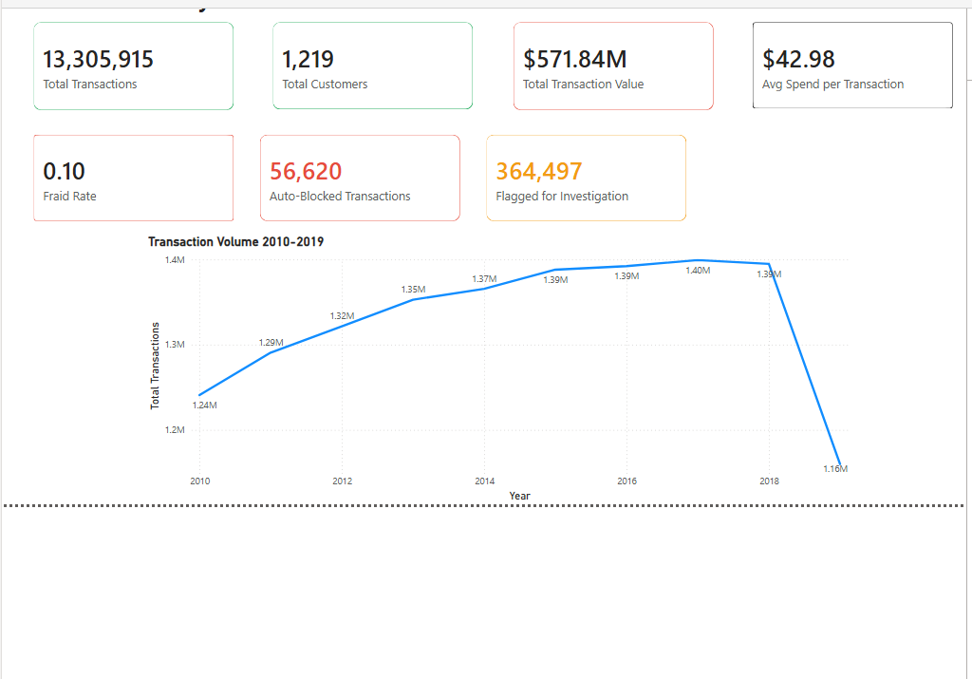
EXECUTIVE SUMMARY ANALYSIS

Slide 24
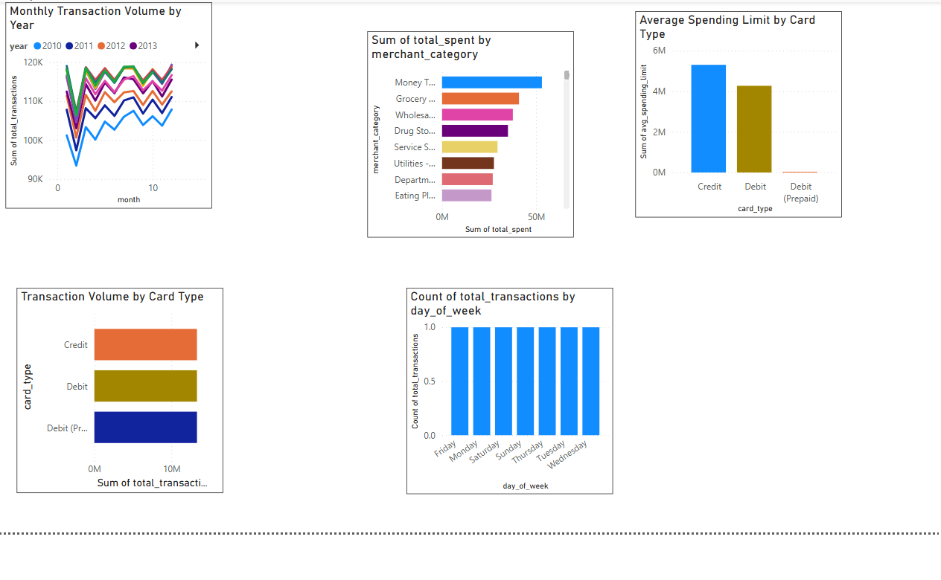
OPERATIONS ANALYSIS

Slide 25
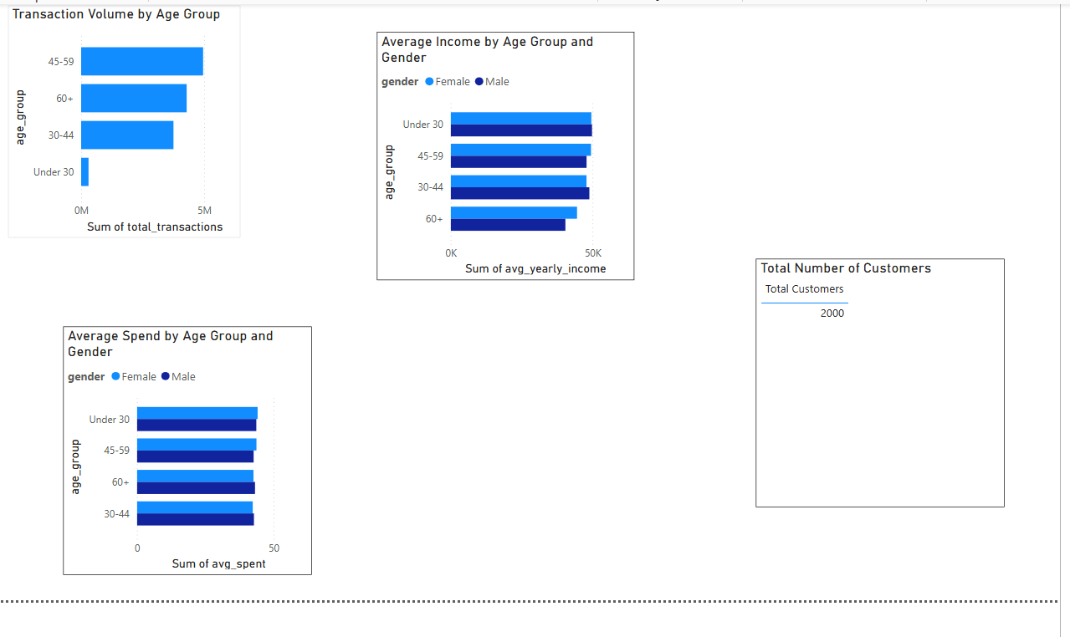
CUSTOMER & RETENTION ANALYSIS

Slide 26
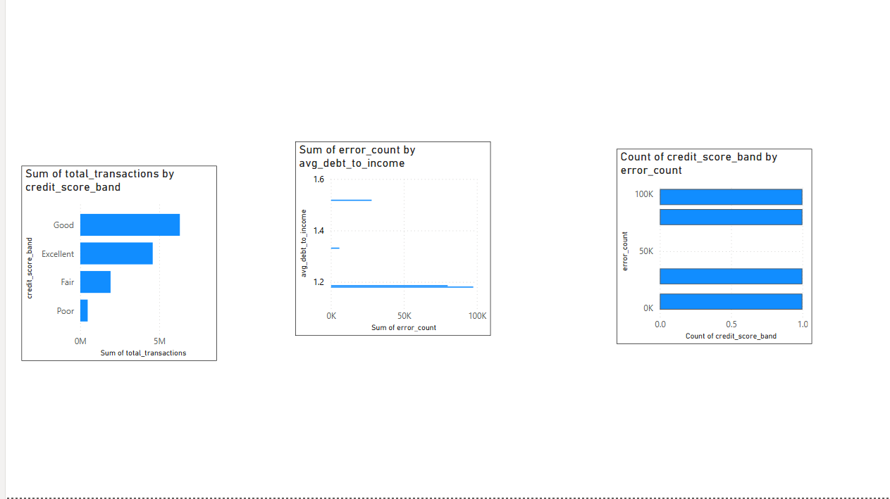
RISK & CHURN ANALYSIS

Slide 27
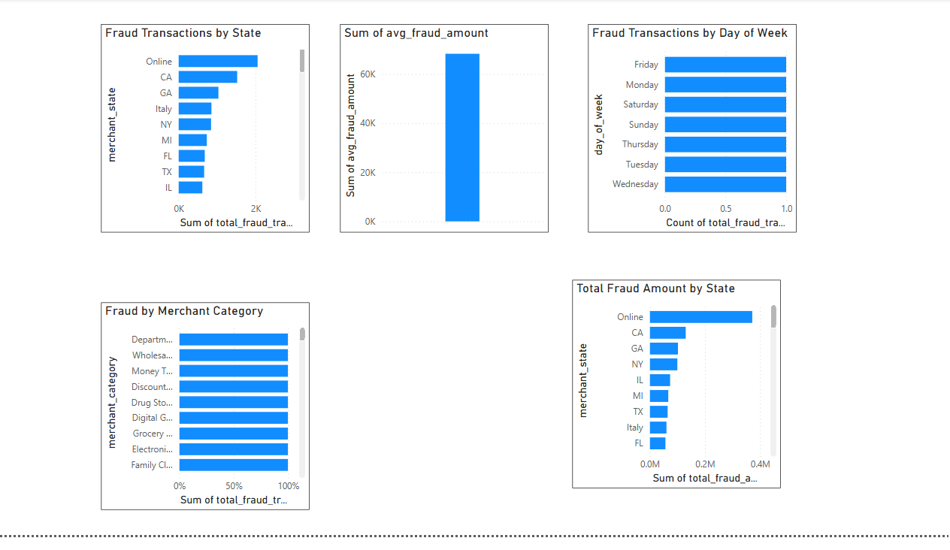
FRAUD ANALYSIS

Slide 28
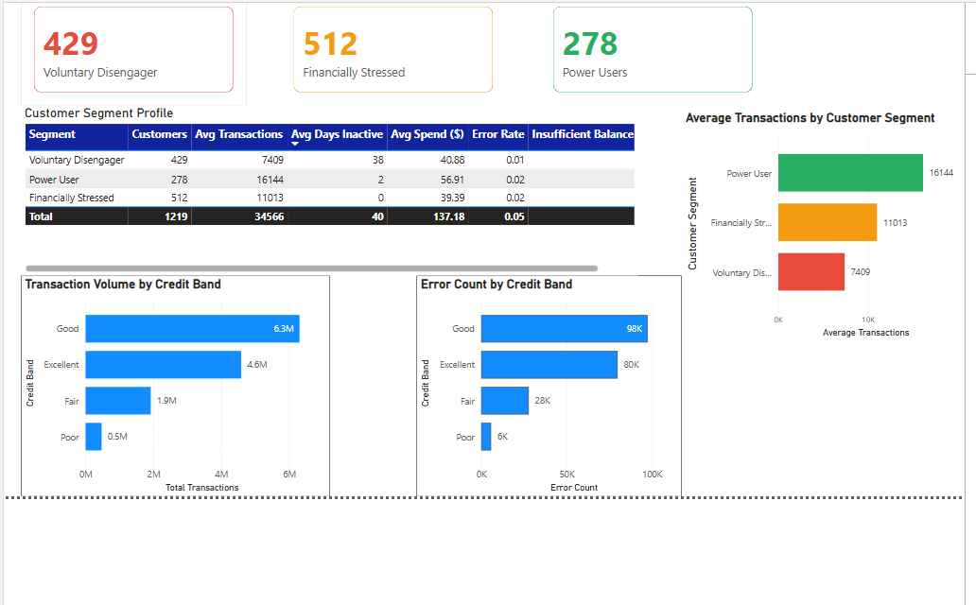
CUSTOMER SEGMENTATION

Slide 29
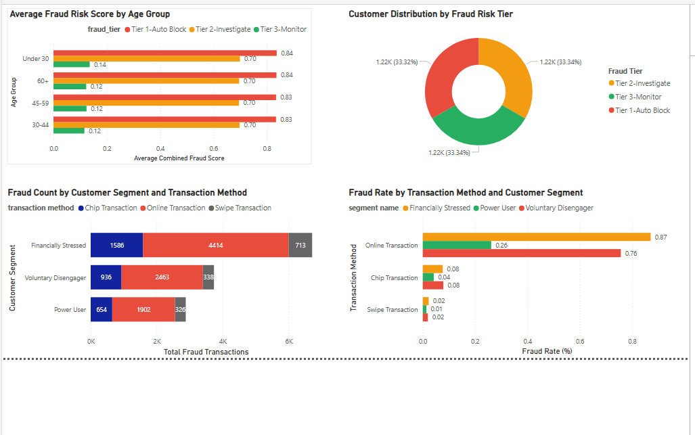
FRAUD RISK & DETECTION

Slide 30
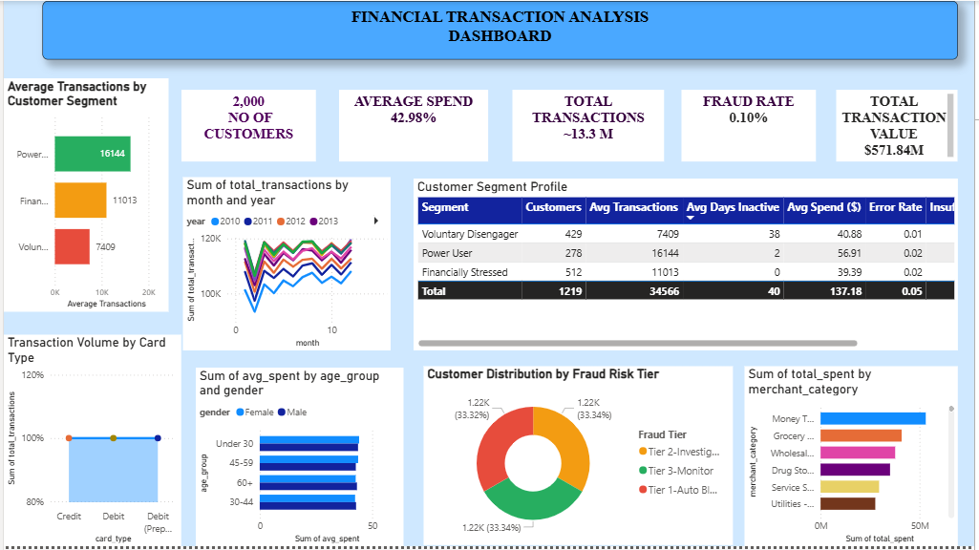
FINANCIAL ANALYTICS DASHBOARD

Slide 31
As a group we did the Azure project setup — provisioned all four services (ADLS Gen2, ADF, Databricks, Synapse), Data dictionary and star schema design
Ujunwa
Databricks to ADLS connection setup
EDA notebook (22 investigations)
Data cleaning notebook
Non-ML Synapse views
Salami
ADF pipeline — 10 datasets and pl_ingest_github_to_raw
Extended ADF pipeline with Databricks notebook activities
Star schema notebook
Executive summary, operations, fraud, customer & retention, financial transactions analysis Power BI dashboards
Natasha
Feature engineering notebook
ML modelling — customer segmentation and fraud detection
Synapse external tables and ML-dependent views
Fraud Risk & Detection and Customer Segmentation Power BI pages
Team Contributions

Slide 32
Thank you

